Slide 1

CS4225/CS5425 Big Data Systems for Data Science
Intro for 2nd Half of Semester
Ai Xin
School of Computing
National University of Singapore
aixin@comp.nus.edu.sg

Slide 2
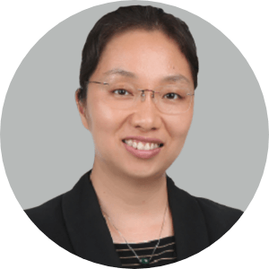
About Ai Xin
Ai XIN
Office: COM3 #B1-24
Phone: 660 16657
Email: aixin@comp.nus.edu.sg
Consultation:
By appointment through email
My research interests: Machine Learning and Deep Learning, Data Analytics and Big Data
Industrial experiences: BHP Marketing Asia
Notes:
Introduction about Ai Xin.

Slide 3
Teaching Assistants
Responsibility
Tutorials
Coding Assignment
We are fortunate to have the following great TAs.
Tutorials and Canvas Discussion
Zhang Ao
Lau Chee Loong, Desmond
Coding Assignment
Group 1 (TA: CHEN XIHAO) 70 students
Group 2 (TA: CHEN JIQING) 70 students
Group 3 (TA: Lim Jun Heng Edward) 70 students
Group 4 (TA: QUEK ZHI HENG) 70 students
Group 5 (TA: Chew Cheng Yap) 69 students
Group 6 (TA: Glenn Lim Jun Wei) 70 students

Slide 4
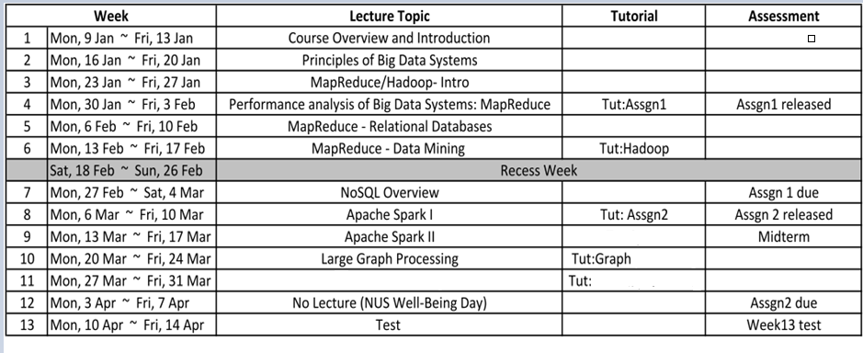
Schedule
Tut: NoSQL + Spark
+ Streaming
Delta Lake
Test Practice

Slide 5
Assessment
2 assignments (25% each)
Midterm (25%) + Week 13 test (25%) – held in-person. Please make sure you can come in-person for the tests.
Midterm: 14-15:30pm March 18, Saturday.
For both Grp L1 & L2.
Venue: UTOWN AUDITORIUM 1/2.
Week 13 test: Apr 13 Thu
Grp L1: 630pm-8pm; Grp L2: 5pm-630pm
(No marks for attendance)
(Note: all in-lecture poll / quizzes are ungraded)

Slide 6
Lecture
In-person lecture
Two groups:
Grp L1: Thu 18:30-20:30 I3-AUD
Grp L2: Thu 14:00-16:00 LT15
Bingsheng for the first half, Ai Xin for the 2nd half
Video recording will be given by CSIT

Slide 7
Lectures
Reference textbooks
Jure Leskovec, Anand Rajaraman, and Jeffrey David Ullman. 2020. Mining of Massive Datasets (3rd ed.). Cambridge University Press. http://www.mmds.org/
Jules S. Damji, Brooke Wenig, Tathagata Das & Denny Lee, “Learning Spark: Lightning-Fast Data Analytics”
Bill Chambers, Matei Zaharia, “Spark: The Definitive Guide”
Martin Kleppmann, “Designing Data-Intensive Applications”
Study materials
Related chapters in the reference textbooks +
The related technical papers/articles (for the state of the art)
Only content discussed in class can appear on tests. Content appearing in the powerpoint notes will not appear on tests.

Slide 8
Tutorials
Starts from Week 4
Tutorials are not counted for final grade
All tutorial questions will be available on the course website before the tutorial
Recommended to attempt questions before tutorial
Some questions are samples for tests

Slide 9
Coding Assignments
Two coding assignments on Hadoop and Spark (50% total)
Sufficient materials will be given to help you do the required set up
Assignment 1 is in Java
Assignment 2 is flexible – you can use Java, Scala or Python
Submission on Canvas
Deadline
Assignment 1: Mar 05, 2023, Sunday 11:59pm (extended)
Assignment 2: Apr 3, 2023, Mon 11:59pm.
Assignment documents will be available on Canvas.

Slide 10
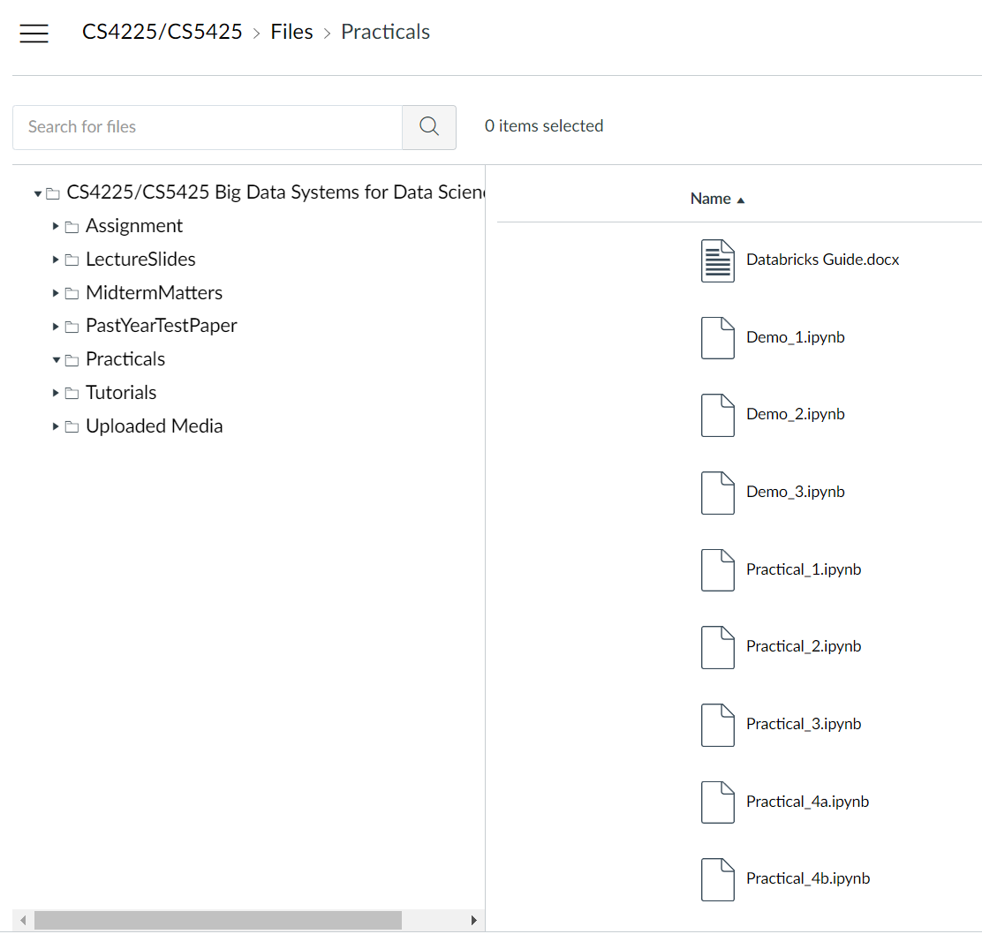
Coding Assignments (cont’)
Individual assignments
Hadoop/Spark Resources
on your local machine
on computing cluster
My expectations
Self-learning is important.
This course does not teach programming.
You’re expected to pick up Hadoop/Spark with the provided materials and other online materials.

Slide 11
Test
Midterm (25%) + Week13 test (25%)
Midterm: 14-15:30pm March 18, Saturday.
For both Grp L1 & L2.
Venue: UTOWN AUDITORIUM 1/2.
Week 13 test: Apr 13 Thu
Grp L1: 630pm-8pm; Grp L2: 5pm-630pm
Venue: UTOWN AUDITORIUM 2
Held in person; open book + notes, but no electronics usage
Focus is on understanding and application, not facts / memorization
Example questions
Integrative: Require you to combine knowledge from different chapters of the textbook
“Application”: Require you to apply your knowledge of fundamental concepts to reasonably practical scenarios.
“Why not”: Example, Tommy proposed a solution A to solve problem B in the lecture. Tell me what is the problem with solution A and how to overcome this problem
Examples will be given during tutorial sessions

Slide 12
Course Policies
Zero‐tolerance for plagiarism
Plagiarism resources
http://www.cdtl.nus.edu.sg/ug/resources/plagiarism.htm
Plagiarism prevention
http://cit.nus.edu.sg/plagiarism‐prevention/

Slide 13
Take-away
All materials are available at course site in Canvas.
Files: Lecture notes, assignments, lab exercises
Canvas Discussion:
We have an especially big class this semester. So, if you have questions of general interest, it is recommended to ask them on the Canvas Discussion as your question may help other students as well.
But if you prefer asking over email, you can email me or TAs but do expect some delays on replying emails.
Feedback and comments are always open.

